Slide 1
Surgeflex Systems

Slide 2
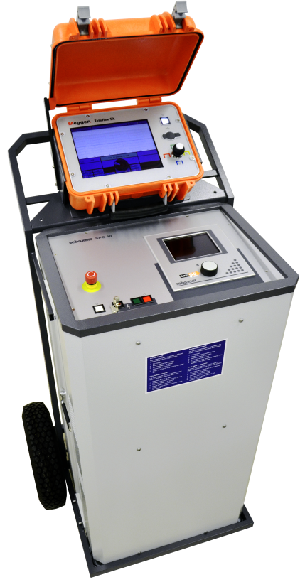
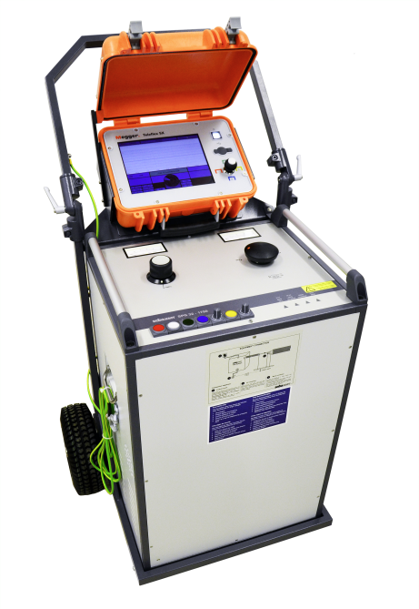
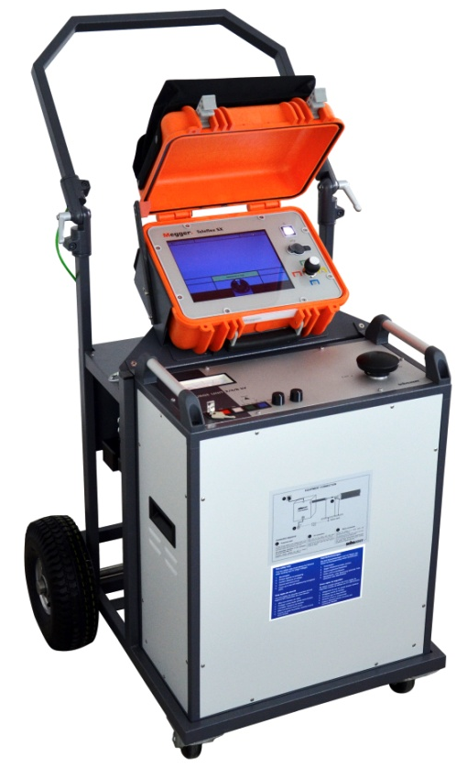
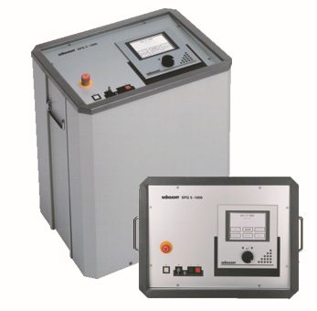
Portable series - Surgeflex
SFX 40
(1000 / 2000 J)
SFX12 / 16 / 32
(1750 / 3500 J)
SFX 8-1000
(1000J)
SFX 5-1000
(1000J)

Slide 3
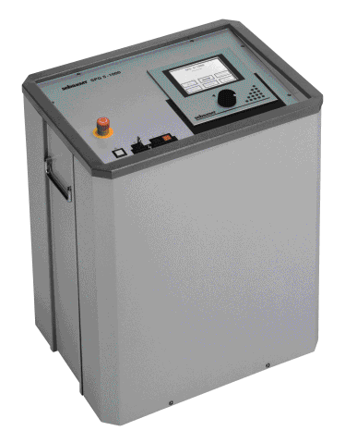
Surgeflex 5-1000 Low Voltage Fault Location System
A complete LV Fault Location System with
one button operation
The solution for branched/T‘eed LV systems
Testing up to 5 kV; Break-Down recognition
Fault conditioning feature / Burning
Pin-pointing with DC step potential
Pin-pointing with SWG acoustic method (1000 J @ 2 kV and 4 kV)
Pre-location with ICEplus
ICEplus technolgy
Requires no TDR evaluation
Direct display of fault distance

Slide 4
Surgeflex 8-1000 Low Voltage Fault Location System
Manually operated System for
LV up to MV applications
Testing up to 8 kV
Three stage capacitor bank
2 – 4 – 8 kV 1000 J
Integrated ARM prelocation
Burn current 1.4 A

Slide 5
Surgeflex 12 / 16 / 32 Fault Location System
3 – 6 – 12 kV 1100 J
or
4 – 8 – 16 kV 2000J
or
8 – 16 – 32 kV 1750 J
Option 3500 J
Option 4 kV 1200 J
Prelocation
ARM, ICE & Decay
Teleflex SX features

Slide 6
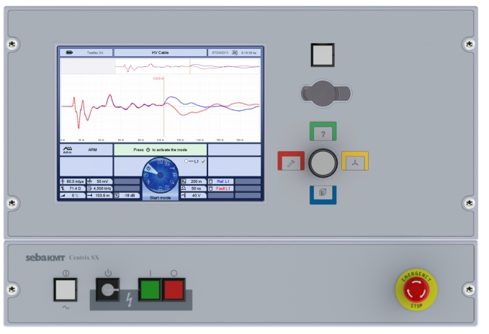
Surgeflex 40 Fully integrated Fault Location System
The new Concept in Cable Fault Location
A complete, fully integrated small fault location system.
Operation from Control panel or Teleflex SX
Integrated ARM, ICE and Decay prelocation
3 or 4 Stage capacitor bank
4 – 8 – 16 – 32 kV 1000 / 2000 J
3 – 6 – 12,5 – 25 kV 1000 / 2000 J

Slide 7
Surgeflex 40 Fully integrated Fault Location System
Central Control and operation
Operation from Teleflex SX
Integrated Safety System
1000 or 2000 J in all ranges
Small dimensions
Low weight
Real ARM (inductive filter)
ICE & Decay integrated
Single Shot Technology
DC Testing up to 40 kV
Fault prelocation up to 40 kV
Sheath testing and pinpointing
Burning

Slide 8
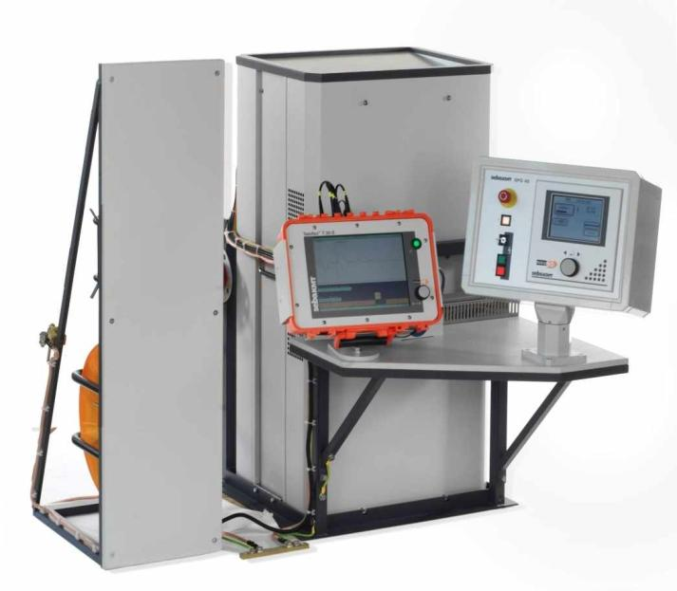
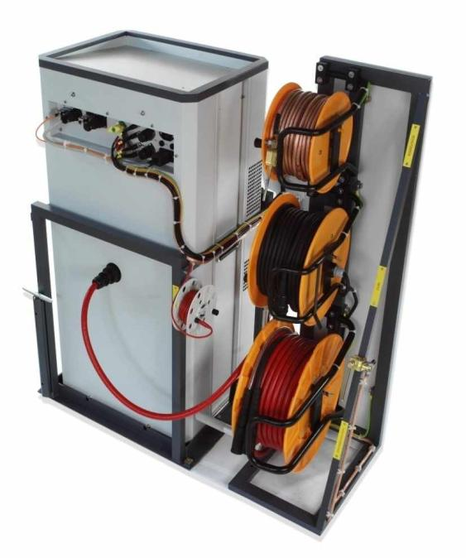
Compact City Small footprint for van mounted fault location systems
Front
Rear

Slide 9
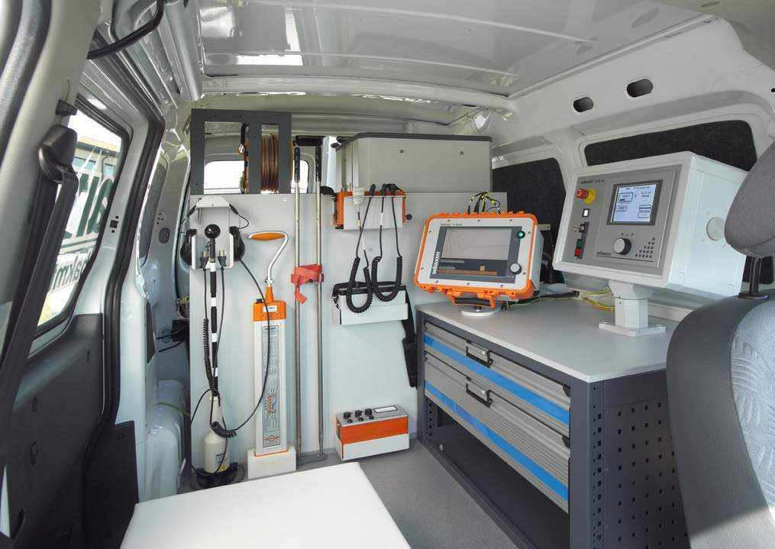
Compact City

Slide 10
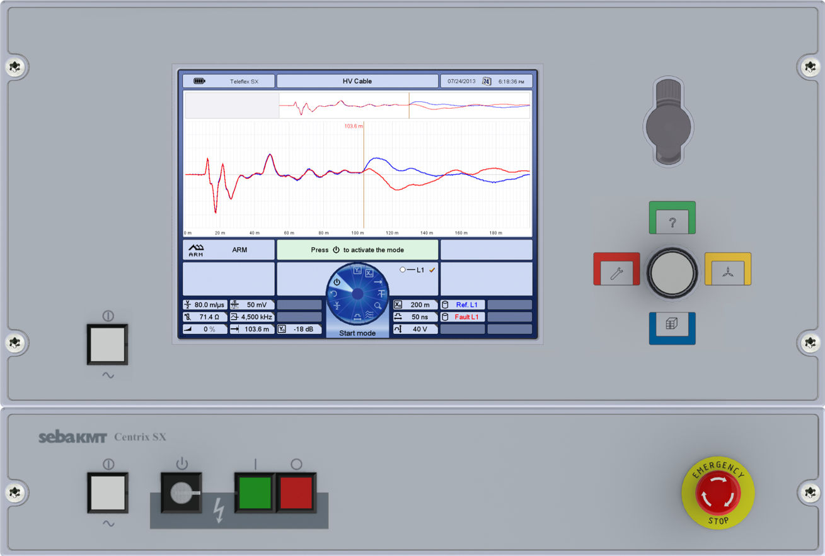
Compact City

Slide 11
Features Portable or van mounted Surgeflex systems
Bright 10,4” Display
Touchscreen and Jogdial Operation
Integrated Battery for 4 hours of operation
Fully automatic, remote Operation of SPG 40
ARMslide Function
ProRange function
IFL Mode
Averaging Function

